Slide 1
Ridge Regression: L2 Regularization
Ankit Bhandari Kshetri

Slide 2
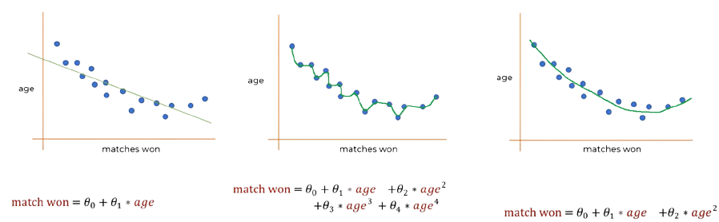
The problem of overfitting
Underfit
Overfit
Balanced

Slide 3

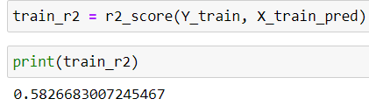
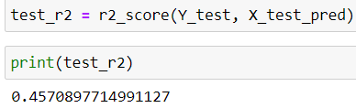
Symptom of Overfitting
On a linear Regression model
Train data Accuracy
Test data Accuracy

Slide 4
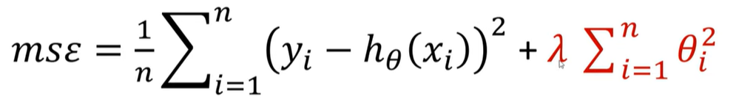
Solution for Overfitting
Regularization
L1: Lasso
L2: Ridge

Slide 5
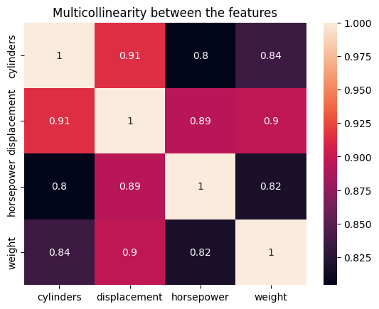
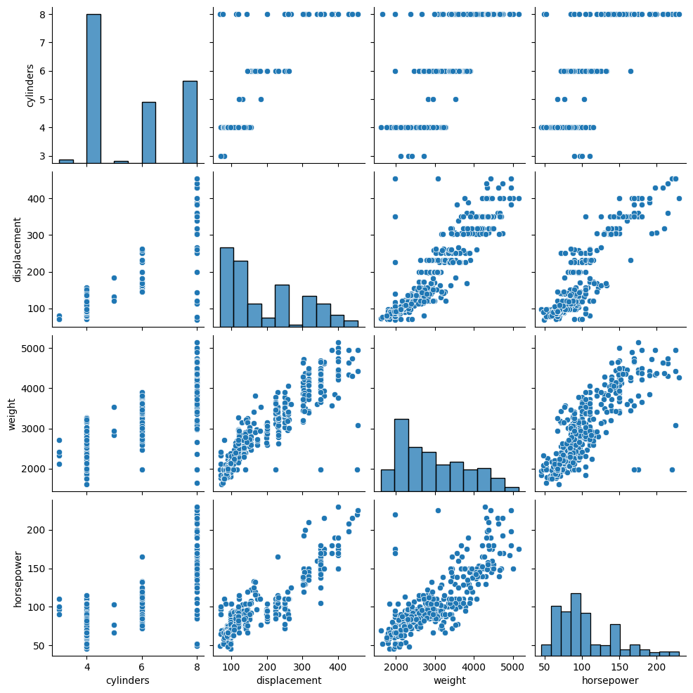
When to use Ridge regression?
Overfitting
Noisy data and Outliers
Multicollinearity

Slide 6
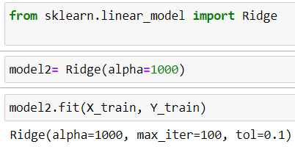
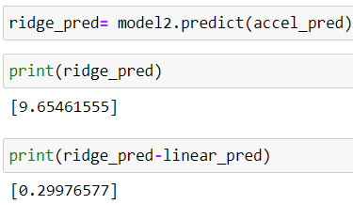

Application of Ridge regression
Improved predicted car acceleration
Improved test data score

Slide 7
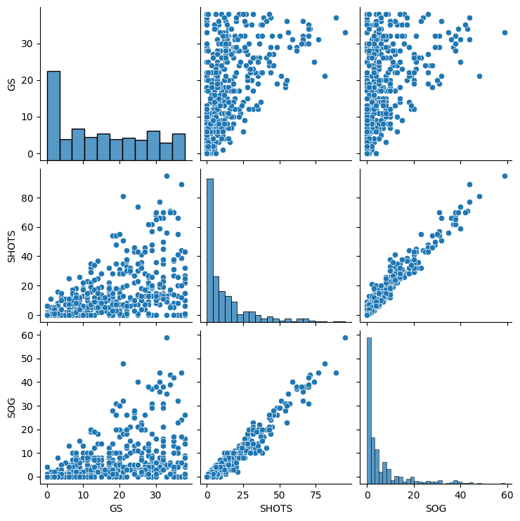
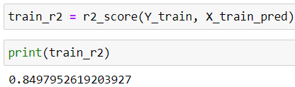
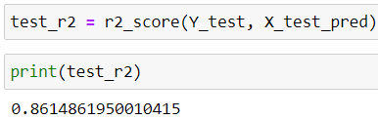
When not to use Ridge(L2 Regularization)?
No significant difference between accuracy of test and train data
2. No MULTICOLLINEARITY

